Slide 1
VOCA Financial & Administrative Training
2022
Oklahoma District Attorneys Council
Federal Grants Division

Slide 2
Webinar Instructions
All participants are muted.
Please “Raise your Hand” if you would like to ask a question.
Please use the Chat or Question to also ask type a question. These boxes are being monitored by staff.
A time for questions and answers will be made available.

Slide 3
VOCA at a Glance
PURPOSE OF VOCA
To provide funding to programs that provide direct service to victims of crime.
PROGRAMS FUNDED
138 VOCA projects
funded in 2022
TOTAL AWARDED:
$18,121,990 which is $136,214 less than in 2021.

Slide 4
VOCA: Victims of Crime Act
Enacted into federal law in 1984.
Established the federal Crime Victims Fund.
Funding is generated entirely by federal fines, penalty assessments, forfeited appearance and bail bonds.
No taxpayer money is deposited into the Crime Victims Fund.

Slide 5
VOCA Fix Update
Directs revenues collected from deferred prosecution and non-prosecution agreements to be deposited into the Crime Victims Fund.
Increases the percentage – from 60% to 75% - of state compensation payments to crime victims in the prior fiscal year used to calculate formula grants for state victim compensation programs.
Directs states to waive the matching requirement for VOCA recipients during and for one year after the pandemic-related national emergency. It also states to waive the matching requirement pursuant to a policy established by the state.
Allows the US Attorney General to provide no-cost extensions to all VOCA recipients (at the state level).
Notes:
Those funds are currently being deposited into the general fund of the Treasury.

Slide 6
VOCA – FUTURE Outlook
2022 VOCA Awards did receive any significant cuts in funding this year.
Awards were based on the 2021 award amounts.
VOCA may receive up to a 70% cut in the next year.
Sustainability Planning has been added as a Special Condition.

Slide 7
DOJ Grants Division Financial Guide
It is imperative that the Project Director and Financial Officer be familiar with the Department of Justice Federal Financial Guide
2022 DOJ Grants Financial Guide
DAC has prepared a Financial & Administrative Guide for Subrecipients. Please review this document as well.
Grants Division Financial Guide
Note: VOCA does not allow for award adjustments without processing a GAN. The 10% rule in the DOJ guide does not apply.
Notes:
Second bullet is where we’d put our comprehensive multi-grant financial guide.

Slide 8
VOCA Federal Grant Program Rules
In addition to the DOJ Federal Guidelines, DAC has prepared the following VOCA Federal Grant Program Rules for your use.
Victims of Crime Act (VOCA Federal Grant Program Rules)
It is imperative that the Project Director and Financial Officer be familiar with this document as well.

Slide 9
REPORTING WASTE, FRAUD, & ABUSE
The subrecipient must promptly refer to DAC, and the Department of Justice (DOJ), Office of the Inspector General (OIG), any credible evidence that a principal, employee, agent, contractor, subcontractor, or other person has, in connection with funds under the subaward, 1) submitted a claim that violates the False Claims Act; or 2) committed a criminal or civil violation of laws pertaining to fraud, conflict of interest, bribery, gratuity, or similar misconduct.

Slide 10
REPORTING WASTE, FRAUD, & ABUSE CONT.
Potential fraud, waste, abuse, or misconduct involving or relating to funds under the VOCA subaward should be reported to:
Office of Inspector General
U.S. Department of Justice
Investigations Division
425 New York Avenue, N.W., Suite 7100
Washington, D.C. 20530
Email: oig.hotline@usdoj.gov
DOJ OIG Hotline: 800-869-4499 (phone) or 202-616-9881 (fax)

Slide 11
Policies and Procedures The following items require a detailed policy and must be uploaded in OKGrants each year
Cell Phones
Relocation – Security deposits must be returned to the to the VOCA Subrecipient program, NOT the client, to be used for other clients.
Transitional Housing – Security deposits refunded by the landlord must be returned to the Subrecipient program, NOT the client.
Emergency Funds
Gift Cards – Clients and advocates must return receipts for the VOCA file (make copies as receipts fade over time). Any unused balance must be returned to the Subrecipient, this ensures the funds are used for allowable expenditures only. See the 2022 VOCA Financial & Administrative Guide for more information.
Vehicles - Request the 13-item policy from DAC
Determination of Suitability
Limited English Proficiency (LEP)
PII – report breach within 12 hours to DAC
Notes:
Policies and Procedures
Relocation and Transitional Housing policies must be modified to include how deposits will be tracked, returned and re-allocated. There should be MOUs with landlords to ensure deposits are refunded properly. Victims must sign an agreement showing they understand that any security deposits returned to them must be returned to the program.
Gift Cards – Remaining balances must be returned to the grant program. Receipts must be copied and kept in the VOCA file to be verified as allowable expenses.
Please refer to the Financial Guide for more information!
Background Check/ Determination of suitability Policy and LEP Policy must be uploaded as well

Slide 12
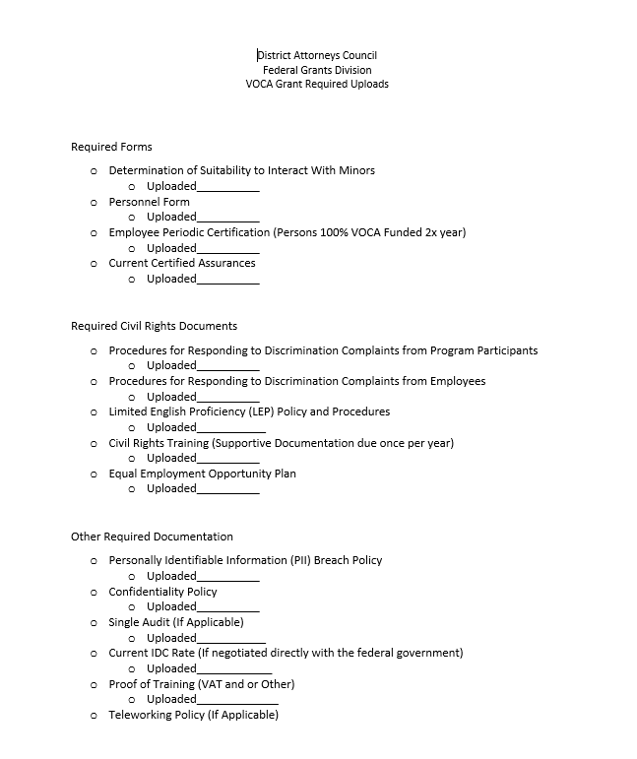

Slide 13
Required Uploads Form link
https://www.ok.gov/dac/documents/VOCA%20Required%20Uploads.docx

Slide 14
Determination of Suitability to Interact With Participating Minors
The subrecipient must determine and document, in advance, the suitability of all persons who may interact with participating minors, including volunteers who may interact with minors.
Certain individuals are prohibited from interacting with minors receiving services in the VOCA-funded program. This link will guide programs on what must be checked and documented in order to comply with this Federal mandate. DAC is required to monitor documentation for compliance.
https://ojp.gov/funding/Explore/Interact-Minors.htm
Notes:
As part of the Certified Assurances subgrantees are required to make a determination of suitability on all employees that have contact with minors.
This is extremely important
Please read and Understand.
Go to the link, read the information

Slide 15
DAC Training Team Contact
The subrecipient at any tier must have written procedures in place to respond in the event of an actual or imminent "breach" (OMB M-17-12) if the subrecipient creates, collects, uses, processes, stores, maintains, disseminates, discloses, or disposes of "personally identifiable information (PII)" (2 CFR 200.79) within the scope of their VOCA-funded program or activity, or uses or operates a "Federal information system" (OMB Circular A-130).
Personally Identifiable Information (PII) Breach

Slide 16
DAC Training Team Contact
The subrecipient's breach procedures must include a requirement to report actual or imminent breach of PII to DAC no later than 12 hours of after an occurrence of an actual breach, or the detection of an imminent breach. The written procedures to respond to an event of an actual or imminent breach should be uploaded in OKGrants.
The DAC has only 24 hours from the actual breach, or detection of an imminent breach, to report to our VOCA Program Manager in DC. Once DAC is notified, we will send you the proper form to complete.
Personally Identifiable Information (PII) Breach
Cont.

Slide 17
Destruction of Records
Record retention and access: Records pertinent to the subaward that the subrecipient at any tier must retain is 6 ½ years from the date of submission of the subrecipient’s final quarterly report. During such time, the subrecipient must provide access, including performance measurement information, in addition to the financial records, supporting documents, statistical records, and other pertinent records indicated at 2 C.F.R. 200.333
Notes:
Record Retention
The federal guidelines state records must be kept for 3 years from the closeout of the grant.
The VOCA federal awards close after 4 years.
However:
DAC could have used funds from prior years to fund your current grant, therefore DAC set the timeline for 7 years to be sure records are available in the event of a federal audit.

Slide 18
Confidentiality
VOCA Victim Assistance Program Final Rule 94.115 Non-Disclosure of Confidential or Private Information:
The VOCA Rule establishes confidentiality and privacy requirements to protect persons receiving services.
State Administering Agencies and sub-recipients must reasonably protect the confidentiality and privacy of persons receiving services under this program and prohibit the release of personally identifying information or client information except in certain circumstances.
The rule allows for information sharing of certain non-identifying data and court-generated information, law-enforcement generated information, and law enforcement- and prosecution- generated information in certain circumstances.
Nothing in the rule prohibits compliance with legally mandated reporting of abuse or neglect.
Notes:
Confidentiality
The VOCA rule requires sub-recipients to protect client confidentiality and prohibits the release of client information except in certain circumstances
The VOCA rule allows for sharing of certain non-identifying data and court, law-enforcement and prosecution- generated information in certain circumstances
Nothing in the rule prohibits compliance with legally mandated reporting of abuse or neglect

Slide 19
Allowable Services
REMEMBER!
Before any service can be performed, that service must first be written in the VOCA Application and approved by the VOCA Board.
Even though a service or cost is allowable, it does not mean it was awarded by the VOCA Board. Review your grant Award Notice. When in doubt, call DAC for guidance.
You can find guidance on Allowable/Fundable Services in the VOCA Final Rule.

Slide 20
Unallowable Costs
Costs that are not awarded in the grant application.
Costs specifically outlined in the DOJ Grant Financial Guide and VOCA Final Rule as prohibited.

Slide 21
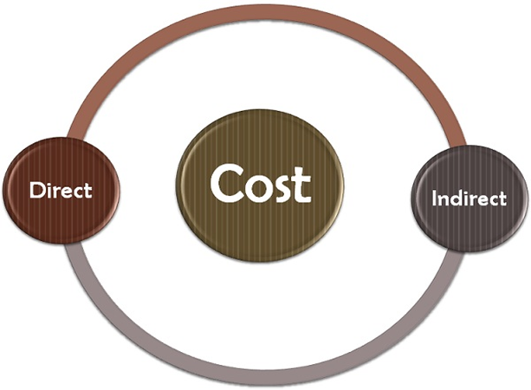
Direct vs. Indirect Costs
Direct costs are those for activities or services that benefit specific projects (e.g., salaries for project staff and materials required for a particular project). These activities are easily traced to projects and their costs are usually charged to projects on an item-by-item basis.

Slide 22
Indirect costs are generally the expenses associated with doing business that are not readily identified with a particular grant, contract, or project, but are necessary for the general operation of the organization. Indirect costs are for activities or services that benefit more than one project. Their precise benefits to a specific project are often difficult or impossible to trace. For example, it may be difficult to determine precisely how the activities of the director of an organization benefit a specific project.
DIRECT
VS.
INDIRECT
COSTS

Slide 23
Direct vs. Indirect Costs cont.
It is possible to justify the handling of almost any kind of cost as either direct or indirect. Labor costs, for example, can be indirect, as in the case of maintenance personnel and executive officers; or they can be direct, as in the case of project staff members. Similarly, material such as miscellaneous supplies purchased in bulk – pencils, pens, paper—are typically handled as indirect costs, while materials required for specific projects are charged as direct costs.

Slide 24
Examples
Costs usually charged directly:
Project Staff
Consultants
Project supplies
Publications
Travel
Costs either charged directly or allocated indirectly:
Telephone charges
Computer use
Clerical and financial staff working with all agency programs
Postage and printing
Miscellaneous office supplies

Slide 25
Examples cont.
Costs usually allocated indirectly:
Utilities
Rent
Audit and legal
Administrative staff
Equipment rental

Slide 26
SPECIAL CONDITIONS
Special Conditions can be found on the Award Notice
Please read special conditions of the grant and share that information with all who are working on the VOCA-funded project, including match personnel
Not all grants have the same special conditions

Slide 27
Award Notice with Special Conditions

Slide 28
Special Conditions on all 2022 VOCA Subgrants
Personnel will aid victims in applying for Victims Compensation.
Advocates employed less than 12 months with no formal victims services training or education will attend online trauma-informed domestic violence training (VAT) or an equivalent within 6 months of hiring and upload verification in OKGrants. Non-attorney victim services advocates will comply with any continuing education requirements. If no requirement exists, advocates will attend training every 3 years with documentation uploaded in OKGrants.
To ensure continuity of victims services and to address a potential reduction of funds, all subgrantees awarded this funding period must submit a sustainability plan by their next application due date to address fiscal and programmatic continuum of services with a focus on detailed coordination and collaboration with community partners.
Notes:
Victim-Witness Coordinators are required to have 12 hrs. of continuing education, by law, each year; therefore, this special condition would not apply to them.
Please be aware that you may have a specific special condition for your agency that is not reflected in these slides. Please be sure to carefully read your Award Notice and all special conditions.
Sustainability special condition - In order to ensure continuity of victims services and to address a potential reduction of funds, all subgrantees awarded this funding period must submit a sustainability plan by their next application due date to address fiscal and programmatic continuum of services with a focus on detailed coordination and collaboration with community partners.
Note: SC says fiscal AND programmatic. Local and state agencies, the SC still applies to you. How are you planning on sustaining constitutionally-required job duties without VOCA funding – victims rights?

Slide 29
SPECIAL CONDITION ON GRANTS FUNDING ATTORNEY POSITIONS
Applies only to VOCA-funded attorneys and those used as match for the VOCA grant.
Special condition requires attorneys attend trauma-specific training during the grant period, provided no such training has been previously attended.
Verification of training should be uploaded into OKGrants.

Slide 30
DAC Training Team Contact
The District Attorneys Council Training Team:
Coordinates free, quality training for VOCA subrecipients and law enforcement agencies.
Publishes a newsletter monthly listing all training available in the state. To see the list of trainings or to request a training, go to the DAC Training Page.
To request training for your organization, contact the DAC Training and Outreach Team at DACTrainingandPublications@dac.state.ok.us .
DAC
TRAINING TEAM CONTACT

Slide 31
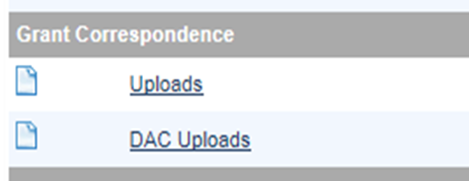
How Do I Show Training Completion?
Scan completion certificates and save to your desktop. When naming the document to save to your computer, reference employee name and type of training (e.g., JSmithVAT).
In the OKGrants Forms Menu, scroll to “Grant Correspondence” and use the first “Uploads” link. Browse and paste training confirmations.

Slide 32
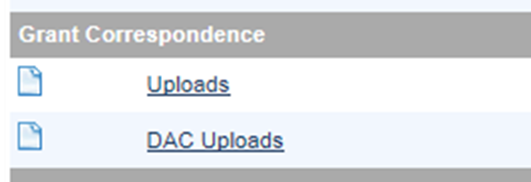
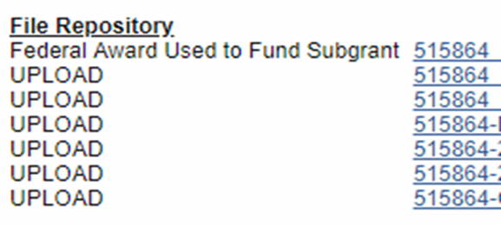
Saved Files
Files are saved into a repository.
Please save all of your VOCA documents as a backup.

Slide 33
Travel
IRS Standard Mileage rate: 0.625 cents https://www.irs.gov/tax-professionals/standard-mileage-rates.
Current State Mileage rate is the same as the IRS standard mileage rate above.
Use map programs, such as Google Maps or MapQuest to document map miles for all in-state travel. Keep documentation and travel reimbursement claims in the VOCA binder.
Rates may be found at the GSA website
Notes:
Non-profits can use a lower mileage rate than the state rate.

Slide 34
Volunteers
Utilizing volunteers is a requirement of receiving VOCA funds.
A volunteer waiver may be requested if all efforts to recruit volunteers have been exhausted.

Slide 35
VOCA Compliance
The VOCA Compliance procedures ensure that all documents required by VOCA are submitted on time:
MFRs, QFRs, SAR, & PMTs
EEOP, Certified Assurances, Periodic Certification
SAM Exclusion/Debarment List
Monthly expenditures and Match to ensure the funds are being expended and reported accurately
Ensuring subgrantees are compliant with special conditions
Tracking of audit requests and final audit reports

Slide 36
VOCA Compliance
Why is this important?
DAC must ensure each subgrantee is in compliance with grant requirements, and ensure, as the State Administering Agency (SAA), we are also in compliance when administering the VOCA grant award.

Slide 37
Late Reports
IMPORTANT: You must submit all MFRs, QFRs (even if there are no expenses to report) and quarterly PMT Reports, as required by DAC.
VOCA Board members receive a list of all subgrantees that have submitted 3 or more late reports throughout the grant year.
The initiation of a monthly request for funds (MFR) will not be permitted in OKGrants after the due date.

Slide 38
Late Reports cont.
First Year following late reporting Special Condition language:
The subgrantee will submit all reports on time and understands that failure to do so may jeopardize future funding and/or result in grant suspension.
Second Year following late reporting Special Condition language:
The subgrantee will submit all reports on time and understands that failure to do so one time will immediately result in grant suspension and funds forfeited for the remainder of the grant year.

Slide 39
VOCA IS A REIMBURSEMENT GRANT!
VOCA project expenses will be paid using another funding source and then “reimbursed” with VOCA funds each month.

Slide 40
Monthly Request for Funds
Submitted electronically in OKGrants.
Due by the 15th of every month at 11:59 pm even if the 15th falls on a weekend or holiday.
Report previous month’s expenses (even if $0).
*Note: Be sure to change the status to “Submitted”

Slide 41
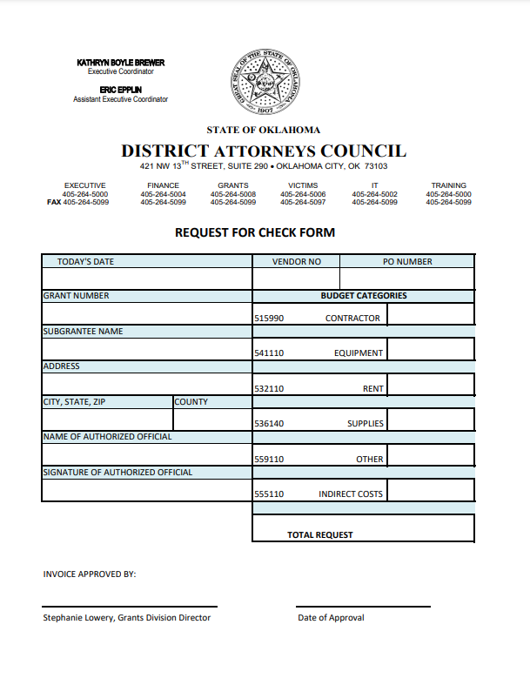
DA Offices
VOCA 22 ledgers will run in the negative each month and “reimbursed” with VOCA funds.
Funds for County level purchases and Indirect costs can be requested using the Check Request Form.
Payroll and Travel expenses are paid through DAC – please reference VOCA.
Email form to: GRANTaccounting@dac.state.ok.us.
Notes:
DA’s Offices only. To be submitted when requesting a paper check to be sent to County Treasurer for purchase of items that are not purchased through DAC (supplies). Please contact Celeste Taylor if you have questions.

Slide 42
DA District Report

Slide 43
Quarterly Financial Reports
Submitted electronically in OKGrants.
Due dates:
1st quarter: 10/1 – 12/31/22 Year 1 due 1/15/23
2nd quarter: 1/1 – 3/31/23 Year 1 due 4/15/23
3rd quarter: 4/1 – 6/30/23 Year 1 due 7/15/23
4th quarter: 7/1 – 9/30/23 Year 1 due 10/15/23
Review Quarterly Reports and compare with your own ledger.
If the 15th falls on a weekend or holiday the report is still due on the 15th.
Notes:
Set a reminder on your calendar for every 15th of the month.

Slide 44
Roles in OKGrants
Notes:
This is how user-based permissions are set up in OKGrants.

Slide 45
OKGrants Demonstration

Slide 46
To initiate a MFR or a QFR, go to My Applications, Select Victims of Crime Act (VOCA) Application 2022 and hit the search button.

Slide 47
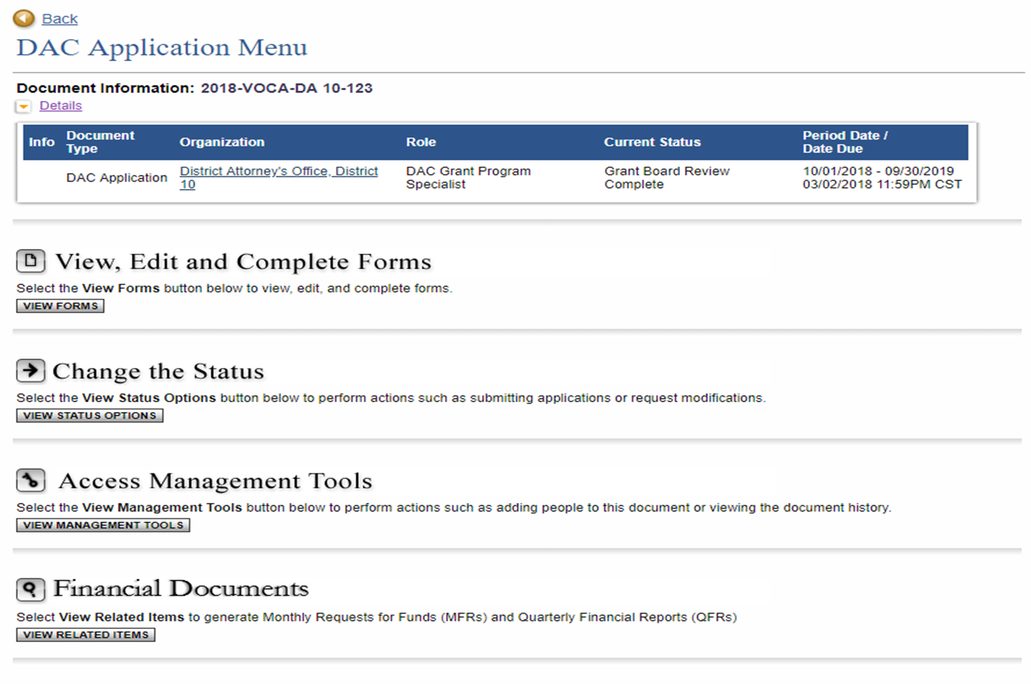
Scroll to Financial Documents and click on View Related Items

Slide 48
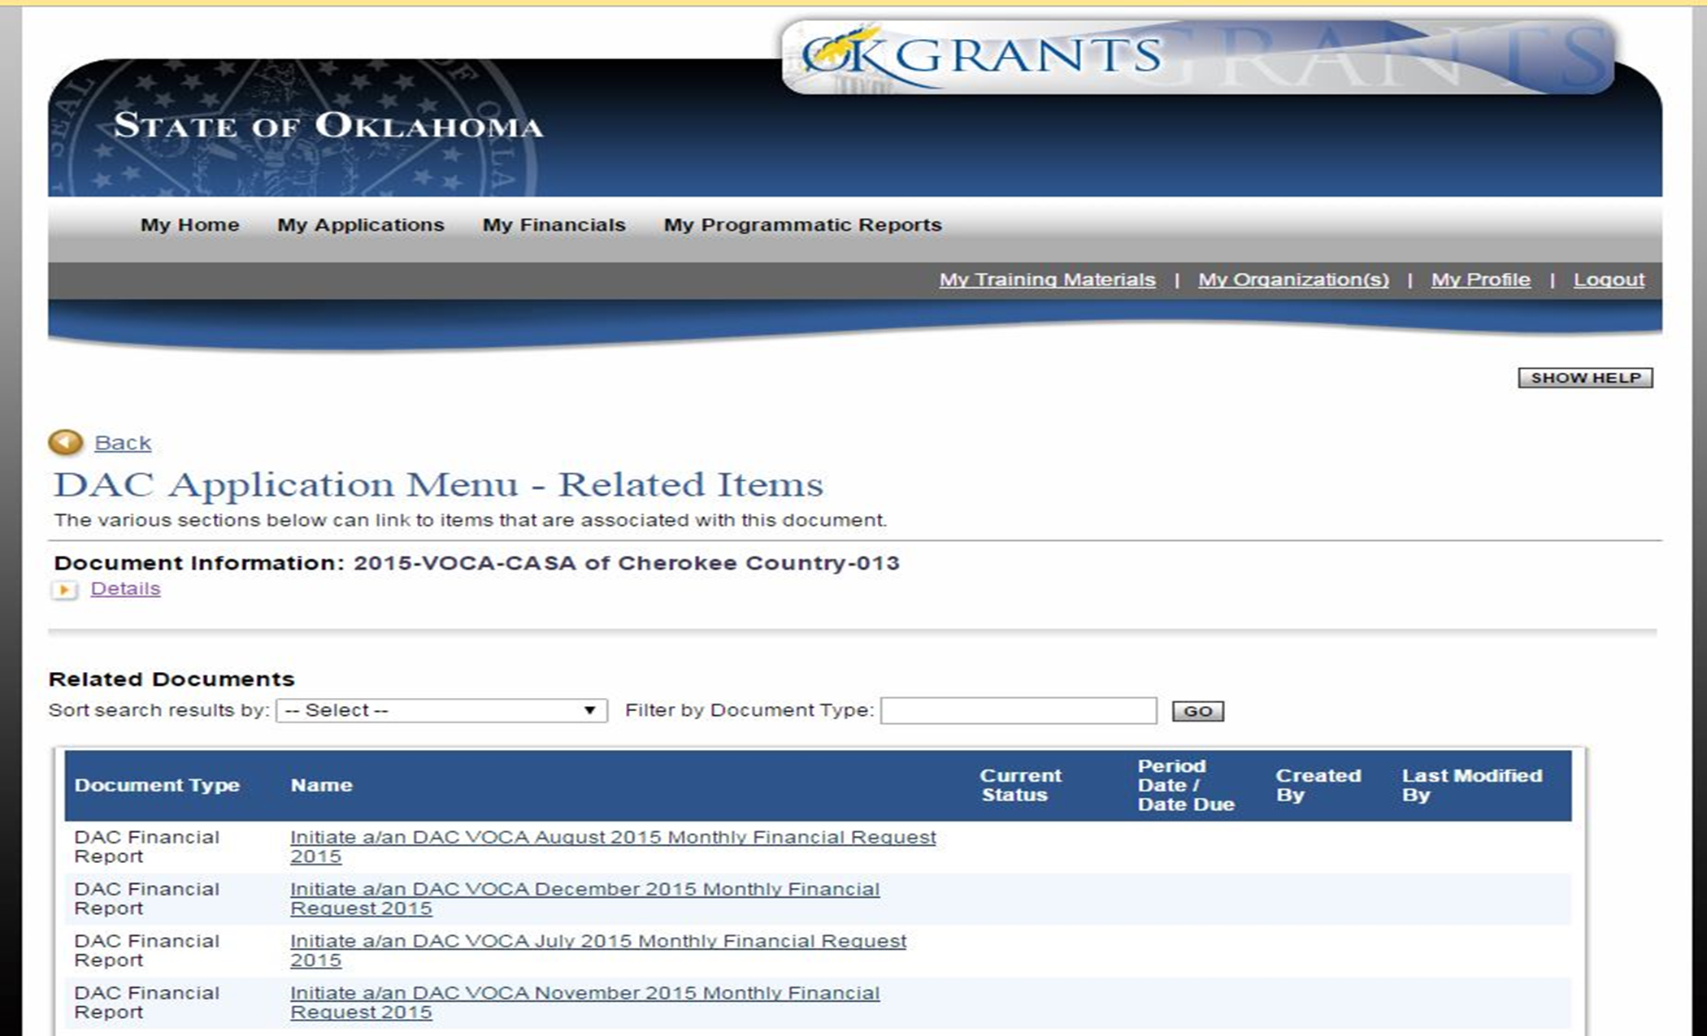
Select the item you wish to initiate
or view the list of items already
initiated and their status.

Slide 49
Grant Adjustment Notice (GAN)
Revision of Approved Subgrant Budget
Personnel Change
Authorized Official, Project Director, Finance Officer
Grant Period Change (rare)
Revisions to Goals and Objectives
Notes:
Initiate a GAN through the OKGrants website

Slide 50
Must be signed and submitted by the Authorizing Official by changing the status of the grant to “Signatures Submitted.”
Financial Officer logs in and signs “Statement of Audit Arrangements” and “Accounting System Review.”
Review thoroughly – this is a legal contract.
Anticipated Award Packet due date: November 15, 2022.
AWARD
PACKET

Slide 51
Monitoring
4 Types of Monitoring
On-site visit (every other year or as needed)
Virtual Monitoring (alternative to On-Site)
Desk Review (ongoing –usually year after on-site or virtual visit)
Phone Monitoring (often follow-up to desk review)
On-Site or Virtual Visit
Scheduled in advance
Includes both financial and programmatic review
Can be performed remotely
Desk Review
Performed in house at DAC, may require the subgrantee to submit supporting documentation.
Notes:
On-site monitoring will now be conducted every other year so you will be seeing a lot more of us!
Due to the increase in VOCA funds, the Office of Inspector General (OIG) is increasing its oversight on the states and therefore upon subgrantees as well.
These notes are older than I am

Slide 52
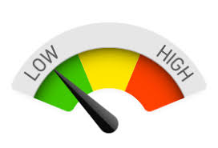
Risk Assessment
VOCA Staff utilizes a Risk Assessment to determine a monitoring schedule. The following criteria are considered on each grant:
Total amount of award
Years of previous grant experience
Frequent turnover of staff
Financial management issues
Significant findings or questioned costs
Recurring or Unresolved Findings
Programmatic Noncompliance
Forfeiture of funds

Slide 53
Top Monitoring Findings
Failure to keep separate accounting of VOCA funds.
Not indicating split in funding sources for split funded employees on timesheets.
Lack of detailed timesheets/activity logs for volunteers and VOCA funded match staff.
VOCA funded staff are not familiar with the goals and objectives of the grant and their expectations.
Submission of late reports.
VOCA funded staff performing unallowable activities.
Unallowable expenditures (e.g., non-emergency food, giveaways).

Slide 54
Top Monitoring Findings cont.
Failure to upload requested forms:
Personnel Form
Periodic Certification Form
Determination of Suitability Form
Inventory Forms
Failure to have proper policies or procedures in place to address:
Limited English Proficiency
Discrimination / Reporting Discrimination
Confidentiality
Notes:
There are sample policies and forms on the DAC VOCA website. Give us a call if you need further assistance.

Slide 55
Contracts
Both consulting and subcontracting agreements should:
Include a description of the service(s) to be performed.
Detail the performance period and associated costs.
Indicate the method and timeline for invoicing.
Include termination provisions.
Invoices from consultants and subcontractors should describe the dates work was performed, the work completed, and the VOCA grant number.
Notes:
In order for a contract to be adequate and allowable, the contract should:
Describe:
Service(s)
Costs
Timeline for invoicing
Termination provisions
Invoices should describe:
Service performed
Dates work was performed and completed,
VOCA grant number

Slide 56
documentation
Binder system is suggested, but not required
Financial ledgers
Timesheets: VOCA grant and match hours MUST be noted on timesheets
Timesheets must be signed and dated by the employee or volunteer and a supervisor
Travel Reimbursement Requests
Receipts
Notes:
In order for a contract to be adequate and allowable, the contract should:
Describe:
Service(s)
Costs
Timeline for invoicing
Termination provisions
Invoices should describe:
Service performed
Dates work was performed and completed,
VOCA grant number

Slide 57
Timesheets

Slide 58
100% allowable activities, 100% funded

Slide 59
100% allowable activities, but only partially funded by voca (everything is voca allowable, but voca does not pay the entire salary) This example shows an employee at 70% funded by voca

Slide 60
70% allowable activities, 70% funded – put exact time

Slide 61
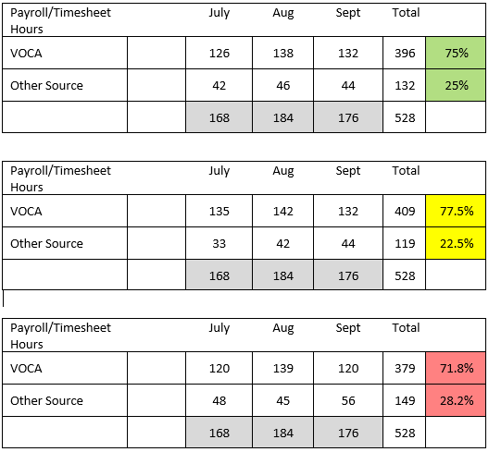
Reconciling exact time – must be done quarterly

Slide 62
Ledgers
Ledgers must be kept to track monthly VOCA deposits, expenditures, and cash match
Ledgers must match the expenses reported in monthly/quarterly reports in OKGrants
Ledgers will be closely reviewed during monitoring visits/desk reviews
Notes:
I don’t feel like the highlighted section is true. All info can be on the same ledger. I see it often. I feel like this is trying to separate ledger by cost. Since IDC is a budget category, it can go on their VOCA ledger.

Slide 63
Forms Contained in this presentation can be found
online at the DAC Website.

Slide 64
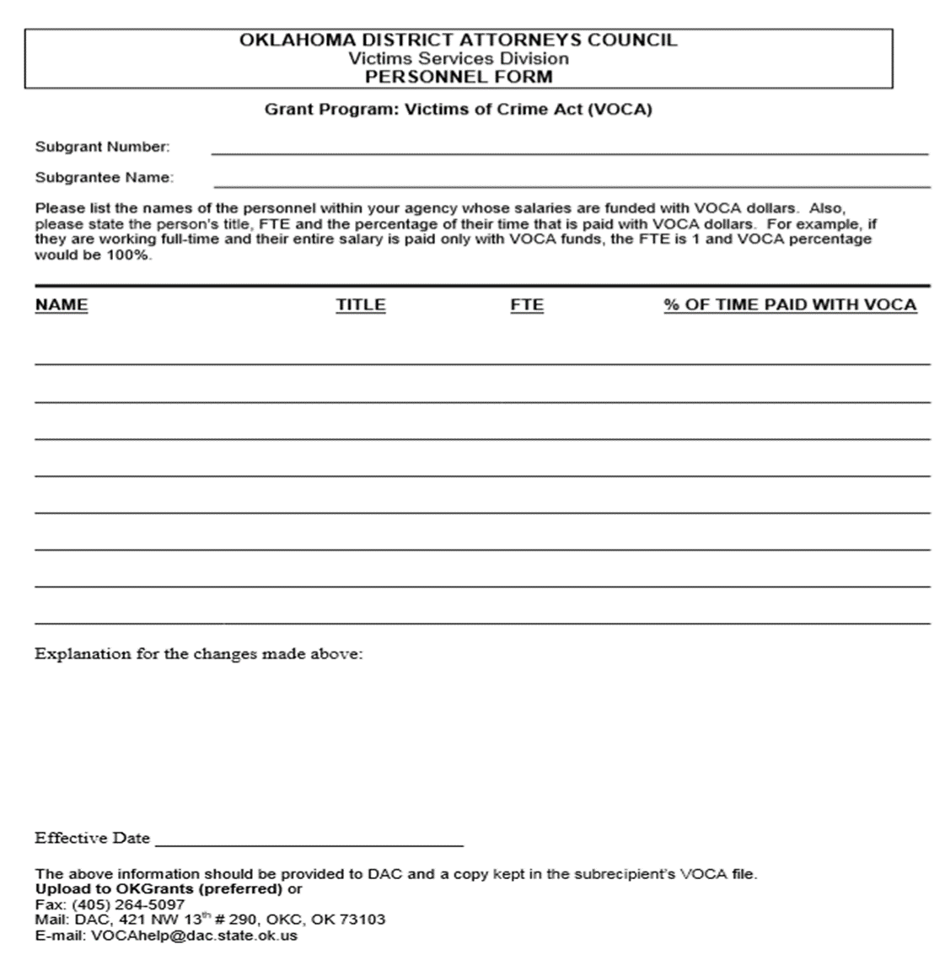
Personnel Form
This form is to be completed with the Award Packet in OKGrants.
List all employees funded with VOCA dollars regardless of percentage of time paid.
This form is to be uploaded within 30 days of ANY change in VOCA paid staff. All employees (not just the new person) need to be listed on the form each time.

Slide 65
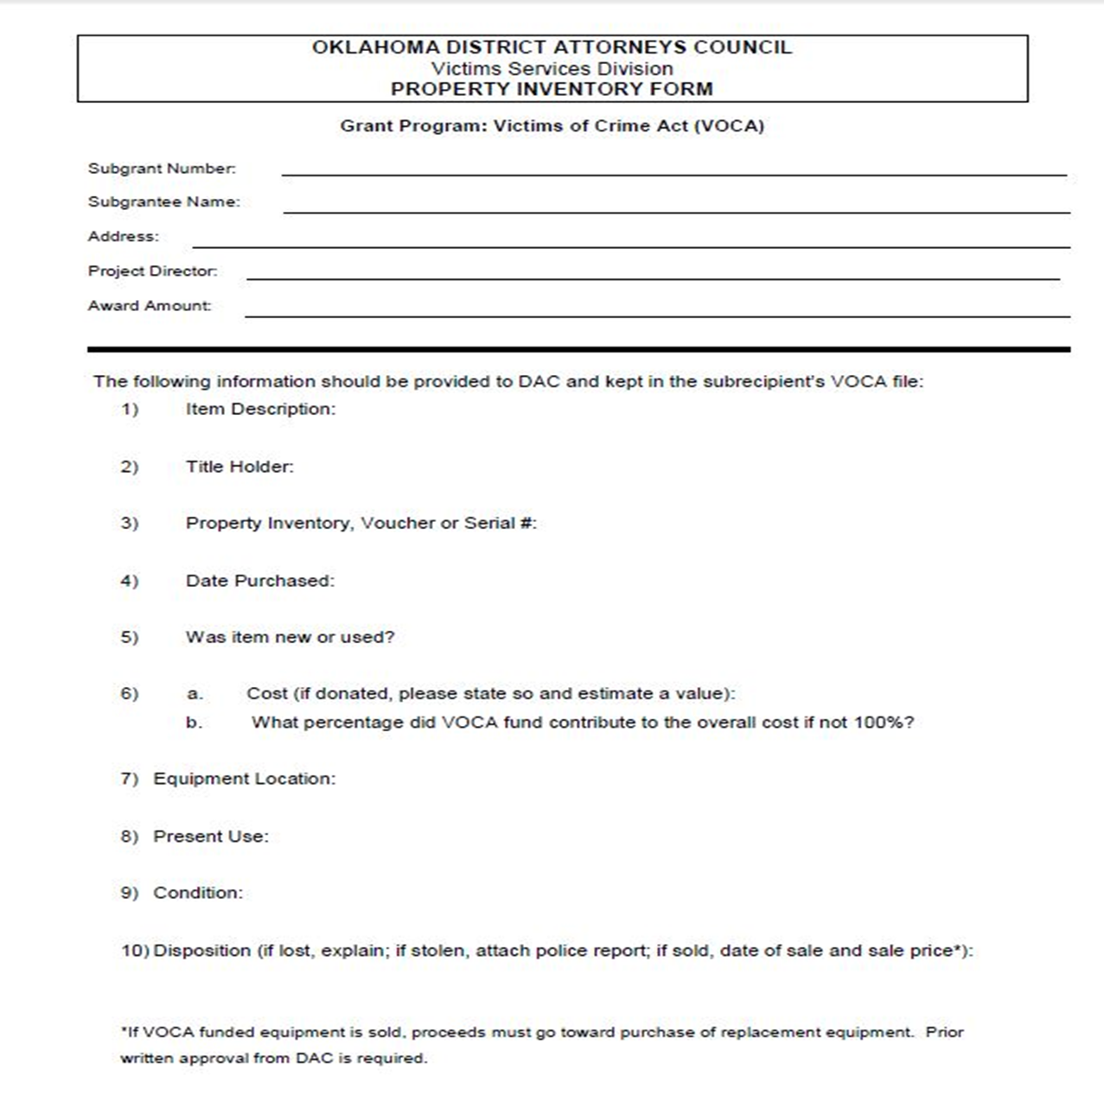
Property Inventory Form
Submitted for each piece of equipment purchased with VOCA or matching funds.
This form is to be uploaded in OKGrants no later than 30 days after purchase of equipment.

Slide 66
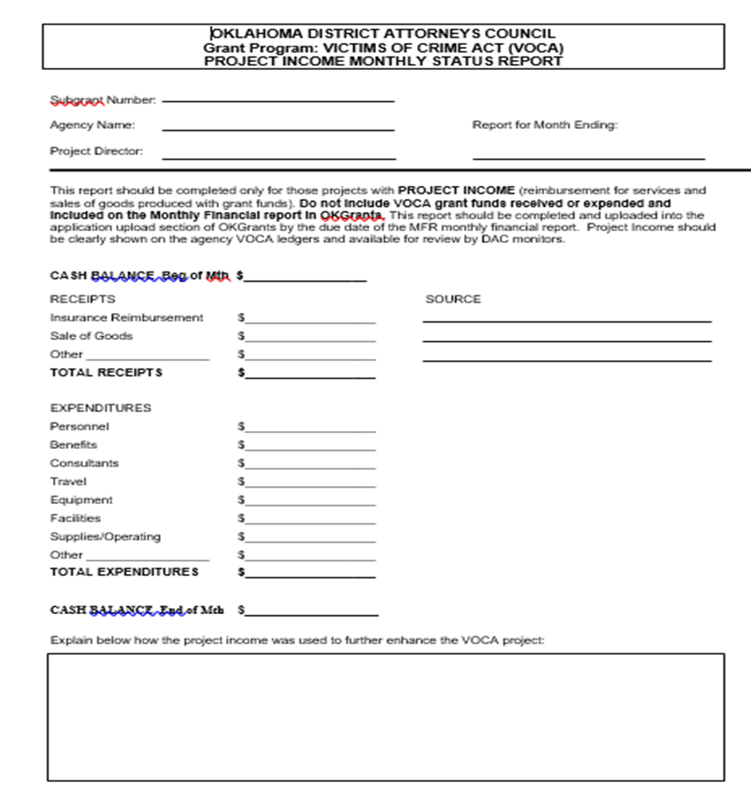
Project Income Form
Send form monthly to report any income earned as a result of the VOCA funded project.
Examples: Billing of Clients, Insurance and Medicaid
Project Income must be used to further enhance the VOCA project and MUST be spent before drawing VOCA funds. The request for funds should be reduced if project income is not expended.

Slide 67
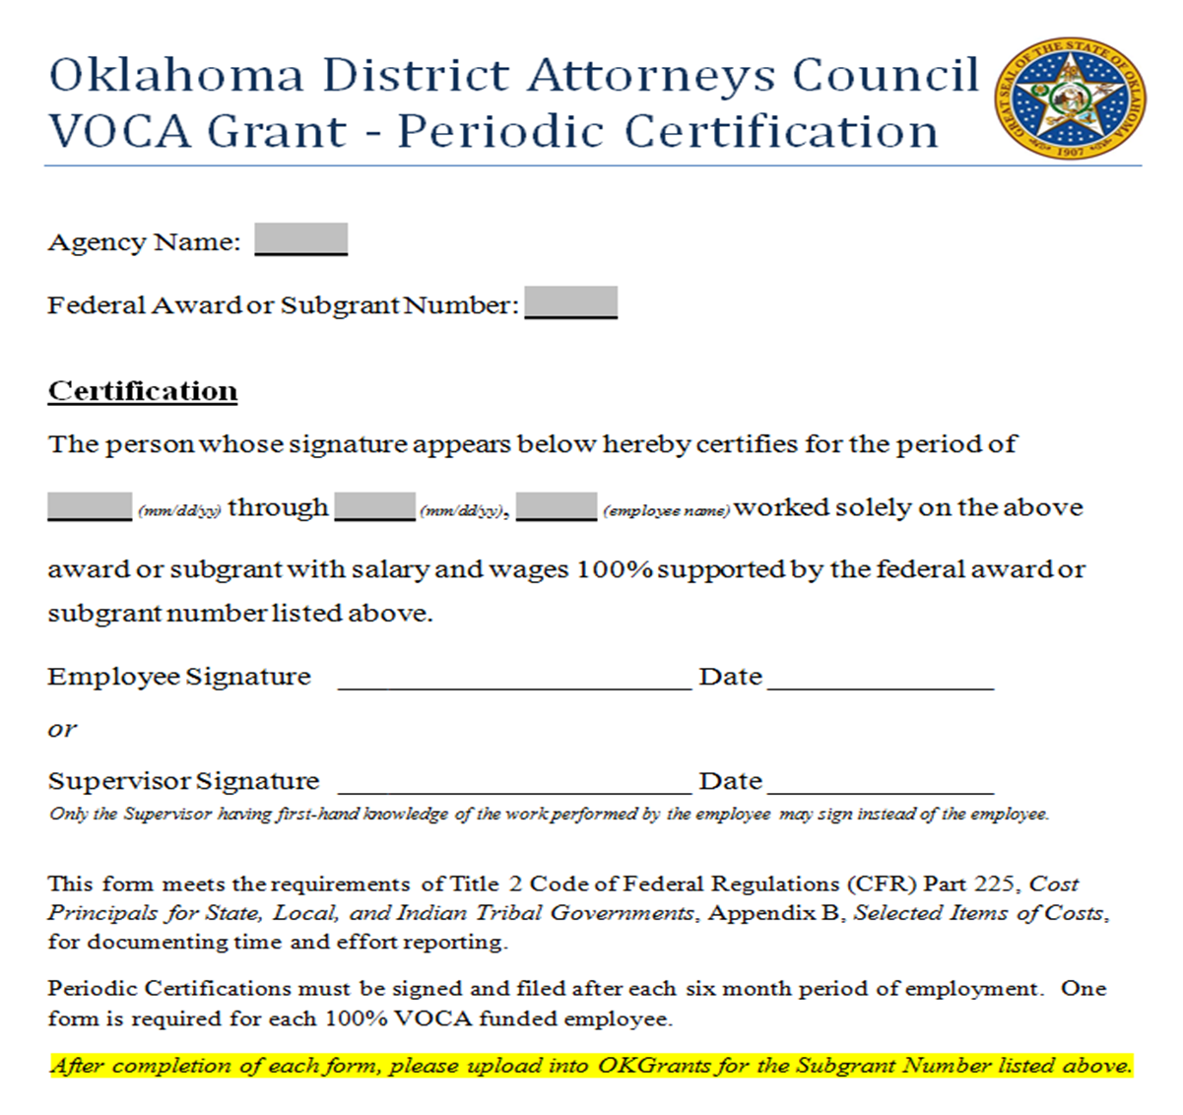
Periodic Certification
In addition to the DAC Personnel Form, this form is to be uploaded in OKGrants every 6 months only for employees who are 100% VOCA funded.
Please complete and upload in OKGrants as follows:
Oct.-March – Upload by 4/30
Apr.-Sept. – Upload by 10/31
PLEASE SET A CALENDAR REMINDER!

Slide 68
The Office for Civil Rights (ocr)
THE OFFICE FOR CIVIL RIGHTS ENFORCES:
Title VI of the Civil Rights Act of 1964 ( race, color, national origin)
Section 504 of the Rehabilitation Act of 1973 (disability)
Title II of the Americans with Disabilities Act (ADA) of 1990(disability)
Age Discrimination Act of 1975 (age)
Title IX of the Education Amendments of 1972 (sex in educational programs)
Program Statutes (e.g. Safe Streets Act, VOCA, JJDPA, VAWA)
(race, color, national origin, sex, religion, disability, sexual orientation, gender identity)
Notes:
Office of Civil Rights Enforces
Civil Rights Act
Rehabilitation Act
Age Discrimination Act
Title 9

Slide 69
Civil Rights Non-Discrimination
Does the agency notify program participants and beneficiaries that it does not discriminate on the basis of race, color, national origin, religion, sex, disability, age, sexual orientation, or gender identity, in the delivery of services?
If so, how? Is it included in posters, brochures or other program materials?
Does the agency notify employees, prospective employees, & volunteers that it does not discriminate on the basis of race, color, national origin, religion, sex, disability, sexual orientation, or gender identity, in employment practices?
If so, how? Is it included on posters, within policy, and or recruitment materials?
Notes:
During a site visit we will ask:
Does the agency notify program participants and beneficiaries that it does not discriminate on the basis of race, color, national origin, religion, sex, disability, age, sexual orientation, or gender identity, in the delivery of services?
If so how? Is it included in posters, brochures or other program materials?
Does the agency notify employees, prospective employees, & volunteers that it does not discriminate
If so how? Is it included on posters, within policy, and or recruitment materials?

Slide 70
Civil Rights Discrimination Complaints
Does the agency have written policies or procedures in place for notifying employees and participants on how to file complaints alleging discrimination by the agency?
Click here for DACs Procedures for Responding to Discrimination Complaints from Clients, Customers, Program Participants, or Consumers of the DAC or any DAC Subrecipient Organization.
Has agency had a finding of discrimination by a federal or state court or a federal or state administrative agency on the grounds of race, color, national origin, religion, sex, disability, sexual orientation, or gender identity during the last three years?
If yes, has agency complied with the requirement to submit the finding to the Office of Civil Rights? If so, what date was the finding submitted?
If yes has the agency reported the finding to DAC?
Notes:
During a site visit we will ask:
Does the agency have written policy for notifying employees and participants on how to file complaints alleging discrimination by the agency?
The District Attorneys Council Procedures for Responding to a Discrimination Complaint is on the website.
Has agency had a finding of discrimination?
If yes, has agency submitted the finding to the Office of Civil Rights? If so, what date?
If yes has the agency reported the finding to DAC?

Slide 71
Civil Rights Questions
Does agency have 50 or more employees and receive DOJ funding of $25,000 or more?
If yes, has the agency designated a person to coordinate compliance with the prohibitions against disability discrimination?
If yes, has agency adopted grievance procedures that incorporate due process standards and provide resolution of complaints alleging discrimination based on disability in employment practices and the delivery of services? Click here for DAC’s Procedures for Responding to Discrimination Complaints from Employees of Sub-recipients.
Notes:
If your agency has 50 or more employees and receive DOJ funding of $25,000 or more
The agency must delegate a person to coordinate compliance with the prohibitions against disability discrimination?
Has agency adopted grievance procedures of complaints alleging discrimination based on disability in employment practices and the delivery of services?
There is a copy of DAC’s grievance policy on our website

Slide 72
Civil Rights Religious Activities
Does agency conduct religious activities as part of its programs or services?
If yes, does agency ensure that it does not use federal funds to conduct explicitly religious activities, and that such activities are kept separate in time or place from federally funded activities?
If yes, does agency provide services to everyone regardless of religion or religious belief?

Slide 73
Limited English Proficiency
To avoid discrimination against LEP persons, subgrantees must:
Take reasonable steps to ensure meaningful access
Establish and implement policies and procedures for language assistance services
Click here for DACs Policies & Procedures to use as a sample.
5 elements of a written LEP Policy:
A process for identifying LEP Persons
Information about available language assistance
Training for staff
Notice to LEP persons
Monitoring and updating the LEP policy
Notes:
Limited English Proficiency Person: Is a person whose first language is other than English and has a limited ability to read, write or understand English.
Subreceipients need to demonstrate that steps have been taken to ensure LEP persons are afforded meaningful access to services
Written Policy must be developed
5 key elements of a LEP policy
There again DAC has a sample policy on the website

Slide 74
What is an Equal Employment Opportunity Plan (EEOP)?
A 2-year plan that will need to be uploaded into OKGrants each year the plan is valid.
If you do not have a current EEOP, you can find the instructions in OKGrants under the EEOP tab.
Note, we do not have access to the EEOP website. Please contact the EEOP helpdesk with assistance in filling out the EEOP form. Click here for an FAQ regarding the EEOP.

Slide 75
Civil Rights Training
Does the agency conduct any training for its employees on the requirements under federal civil rights laws?
Office for Civil Rights – Civil Rights Pre-Bid Training for Grantees
Notes:
It is a requirement that subgrantees provide yearly Civil Rights training to all employees and not just those funded by the federal
There is a PowerPoint on the DAC website
the Attendance form or proof of attendance must be uploaded in OKGrants

Slide 76
Publications Blurb
In all materials publicizing or resulting from award activities, you must acknowledge awarding agency assistance. An acknowledgement of support shall be made through use of the following or comparable footnote:
“This project was supported by Award No.XXXXX awarded by the Department of Justice, Office for Victims of Crime.”
Notes:
If within your award you received funds to publish materials you are required to provide this Blurb
Stevens amendment?

Slide 77
2022 Certified Assurances
The 2022 Certified Assurances will either be within the Award Documents or sent separately, must be signed and dated by:
Authorized Official
Project Director
Financial Officer
Notes:
FIX THIS SLIDE

Slide 78
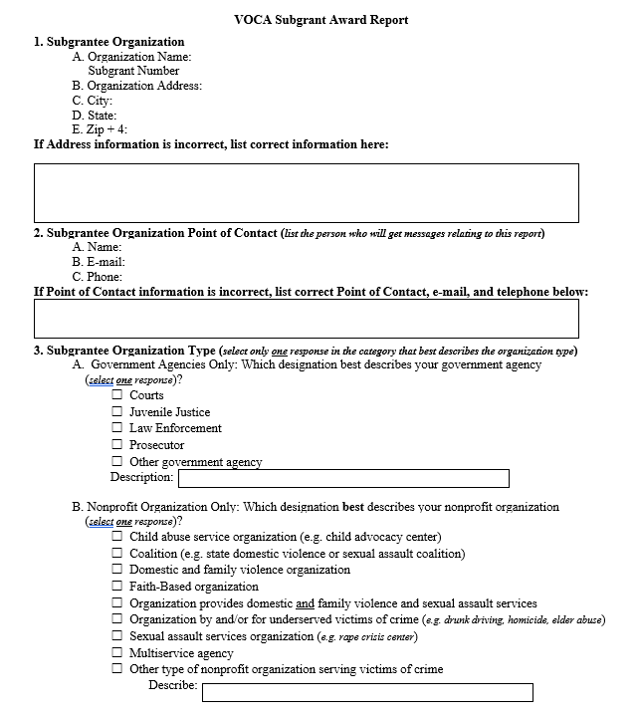
Subgrant Award Report (SAR)
We will be discussing the SAR in more detail this afternoon.
Notes:
Should we prepare new slides for all of this?

Slide 79
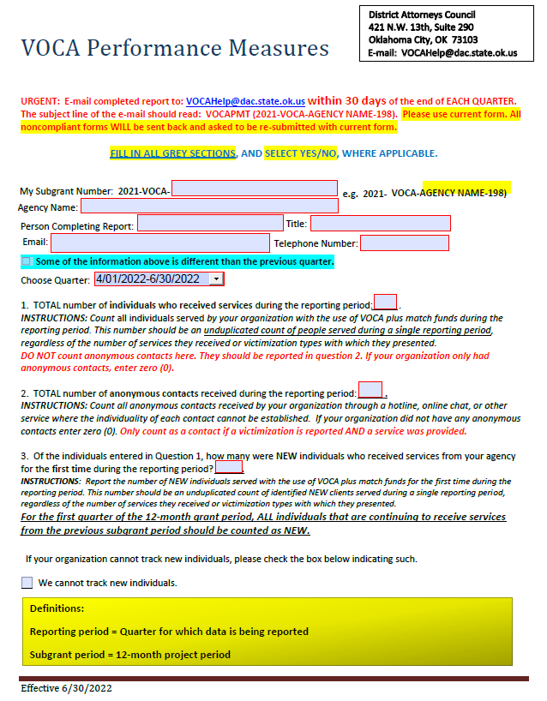
Quarterly Performance Measurement Tool (PMT)
Monitors will be reviewing your data collection method at on-site visits as required by OIG
New subgrantees must attend the afternoon session
We will be covering the end of the grant period narrative questions during the afternoon session
Effective October 1, 2017, the VOCA Board voted to include the PMT on the late reporting list

Slide 80
Reminders!
Subgrant Award Report (SAR) due: October 17th (a customized form for each Subgrant program will be e-mailed)
Signed Grant Award Contracts due: November 15th
The following items by November 15th:
Signed 2022 Certified Assurances
Determination of Suitability to Interact with Participating Minors
Special Conditions
Requested MOUs
Leased Vehicle Special Condition
Revised Policies and Procedures
Gift Cards and transitional housing deposit returns
Revised Goals and Objectives
First Drawdown (Oct. Reimbursement) due: November 15th
Notes:
Are we needing signatures before the first draw or after the first month?
SAR will be due as soon as we create the award tool and put in our 22 fed number
What is NOT due by Oct 31? What uploads are due when? Uploads schedule on ok.gov/dac?

Slide 81
Upcoming DAC VOCA Schedule
December 3, 2022 - Open 2023 Grant Solicitation (grant period will be 10/1/21 – 9/30/22)
March 4, 2023 - Grant Due Date
March – June, 2023 - Analyze VOCA requests and work on Grant Adjustments (existing grants)
May – July, 2023 - Prepare staff recommendations and Board meeting documents
July 12, 2023 – Last date to submit Budget GAN (if needed)
August 3-5, 2023 - VOCA Board meeting
August-September 2023 - Prepare award documents, conduct financial training, subgrantees advertise for new staff (if applicable) and prepare to close out 2021 grants.
October 1, 2023 - New Grants Begin
Notes:
Due first Friday of March, so March 3^{rd?}

Slide 82
Informing victims on the availability of crime victims compensation is a VOCA requirement. Direct victims to the Crime Victims Compensation Program Website for a claim form.
Contact DAC at (405) 264-5006 or email victimsservices@dac.state.ok.us for brochures, claim forms, posters (also available in Spanish); and Victims Compensation Program training for your organization.
Get to know the Victim Witness Coordinator in your local DA’s Office.

Slide 83
Please ask victims to read the Fund Eligibility requirements under the Compensation Program tab BEFORE filing a claim. Property crimes are not eligible.

Slide 84
www.okvictimscomp.com
Please ask victims to read the Fund Eligibility requirements under the Compensation Program tab BEFORE filing a claim. Property crimes are not eligible.

Slide 85
Twitter: Username: OCVCSocial
Facebook: Oklahoma Crime Victims Compensation
LinkedIn: Oklahoma Crime Victims Compensation
YouTube: Oklahoma Crime Victims Compensation Social
Notes:
We had this page when we were still in the Victims Division. Do we remove or leave?

Slide 86
Questions?

Slide 87
Contact
District Attorneys Council
421 N.W. 13th Street, Suite 290
Oklahoma City, OK 73103
405-264-5008 phone
405-264-5099 fax
VOCAHelp@dac.state.ok.us*
*Important: When emailing DAC or VOCAHelp, please put your grant number (e.g., 2021-VOCA-DAC-001) in the subject line and your agency name and contact information in your signature line.

Slide 88
Staff
Robin Frank
VOCA Grant Program Specialist
Robin.Frank@dac.state.ok.us
Jaime Yahner
VOCA Grant Program Specialist
Jaime.Yahner@dac.state.ok.us
Connor Long
VOCA Grant Program Specialist
Connor.Long@dac.state.ok.us
Stephanie Lowery
Director of Federal Grants Division
Stephanie.Lowery@dac.state.ok.us
Michelle Naylor
VOCA Financial Manager
Michelle.Naylor@dac.state.ok.us

